Slide 1


Patterns in Node Package Vulnerabilities
Chetan Karande
Notes:
Welcome Everyone! My name is Chetan Karande. Thanks for joining this session.

Slide 2
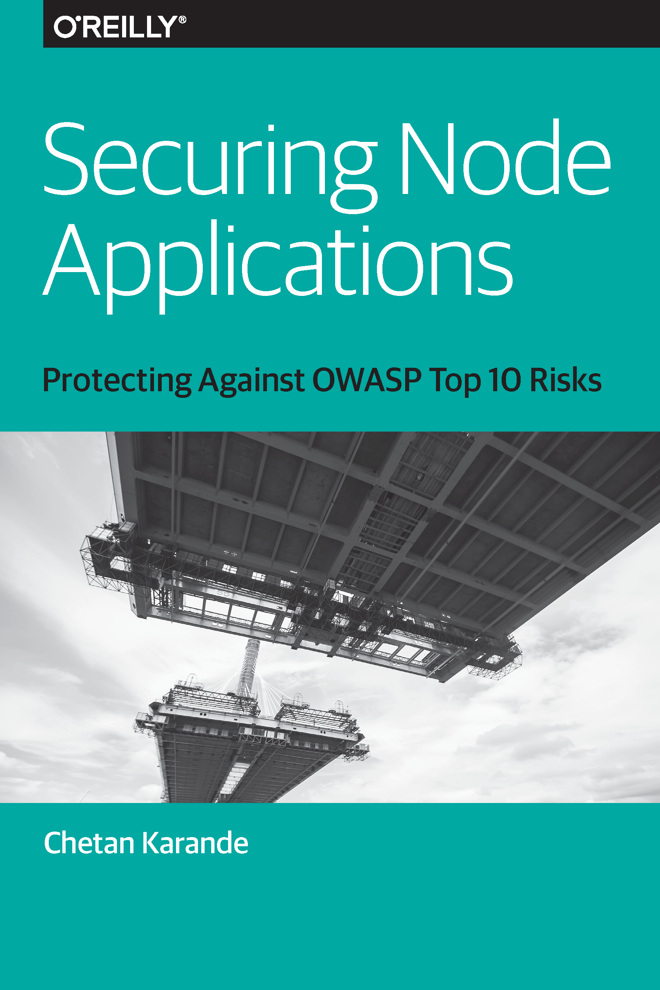

About Me
Principal Engineer, DTCC
Project Leader, OWASP NodeGoat Project
Author

Slide 3


532 packages/day
Notes:
Over 500 reusable packages getting added to the npm registry every day

Slide 4
~ 700,000 packages
Notes:
close to 700 thousand packageson the world’s largest package registry

Slide 5

88 Disclosures
Notes:
88 Node package Security Disclosures on HackerOne

Slide 6

603 Vulnerabilities
Notes:
598 Node Package vulnerabilities reported by the Node Security Project

Slide 7

1,098 Advisories
Notes:
Over Thousand Node package Advisories reported by Snyk.

Slide 8

Notes:
What story do these numbers tell us? In this session we are going explore that
Yes..this story has some scary parts as well as some hope and positive things.
I believe we all love stories with happy endings.. So start with the struggles first

Slide 9
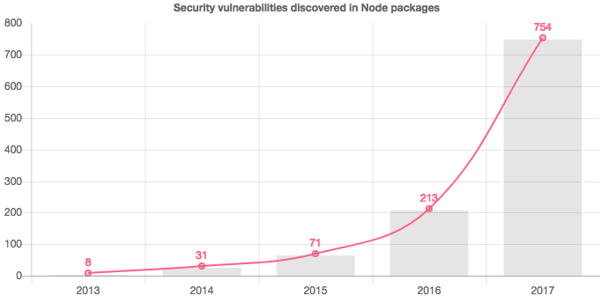
Notes:
This chart shows titile
since 2013,
As we can see these numbers have increased at an exponential rate every year.

Slide 10
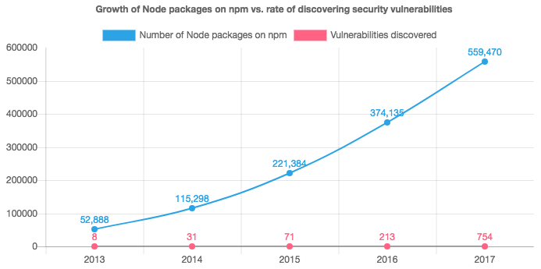
Notes:
Even though we see a healthy growth in vulnerabilities reported year by year, if we plot the same numbers against packags published on npm per year, we get this chart
Blue line
Red line
As we can see, slope of the red line is almost flat.
There is huge gag in pace of discovering node package vulnerabilities and the pace with with new packages and their versions appearing on npm.
1 vulnerability in evy 600 packages released on npm
Just to get a sense of how huge this gap is put this gap and numbers in a different context…

Slide 11



Notes:
If we map Total number of packages on npm to Sun’s diameter

Slide 12

Notes:
then number of known package vulnerabilities comes out to be merely 1/6th of the Earth’s diameter. This doesn’t even consider multiple versions of package on npm.
**** Although you can interpret this shortfall in the in favor of npm packages, considering they are inherently secure;
the most likely reason for this gap is the speed of new Node packages appearing on the npm registry predominantly outpacing the limited capacity of security researchers to discover and responsibly publish security advisories.
This also means that there is a good chance that a package upon which an application depends never underwent a security review, which is a huge risk.

Slide 13
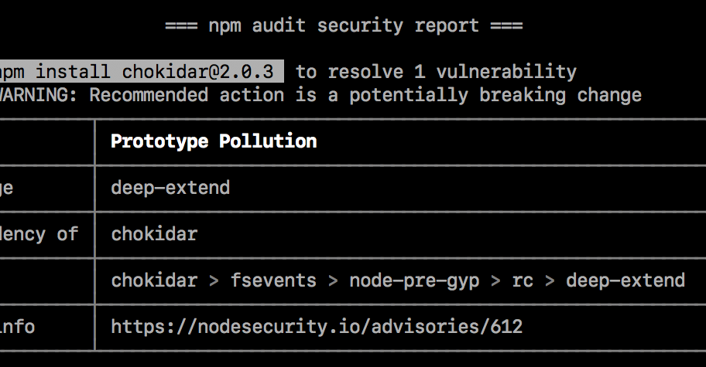
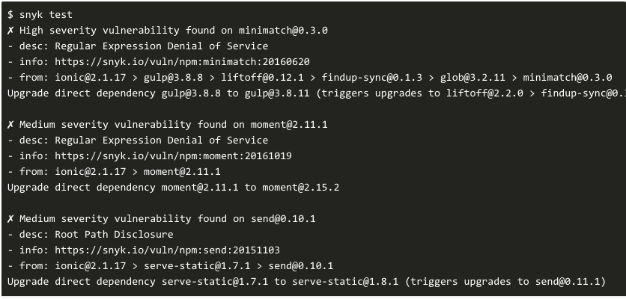
npm audit
Snyk CLI
Notes:
What about tools such as npm audit or Snyk that most of the Node developers use to scan for and keep track of vulnerable dependencies in applications? Are they sufficient?
Even though using these tools is indispensable; these tools are not sufficient to reliably detect insecure dependencies.
Because under the hood these tools use the publicly known advisories database to validate project dependencies, and current advisories data is not extensive enough.
That is the scary part of the story, but as I mentioned earlier the story ends with a hope and positive things . So let move to the positive things …

Slide 14

“By seeking and blundering we learn.”
- Johann Wolfgang von Goethe
Notes:
Now about Positive part of the story.
Even though not comprehensive, The currently known advisories are a great learning resource. We can learn from these security mistakes done by other package authors.
These lessons are helpful not only to package authors but equally useful to Node.js application developers and security testers.
So what is the best way approach learning from t
hem? If we just synk advisories databse and start reading advisories , it may not be the most efficient way.
We need a big picture to begin with.

Slide 15

Notes:
while working on this report, I took all advisories feeds published by Snyk and Node Security Platform. I filtered out the duplicates, and ended up with 1023 unique advisories.
Then I wrote little script to categorize them base on the keywords in tiltle and description

Slide 16

1,084
+
528
1,023 Unique Advisories
Notes:
So while working on this report, I took all advisories feeds published by Snyk and Node Security Platform.
I filtered out the duplicates, and ended up with 1023 unique advisories.
Then I wrote little script to categorize them base on the keywords in tiltle and description

Slide 17
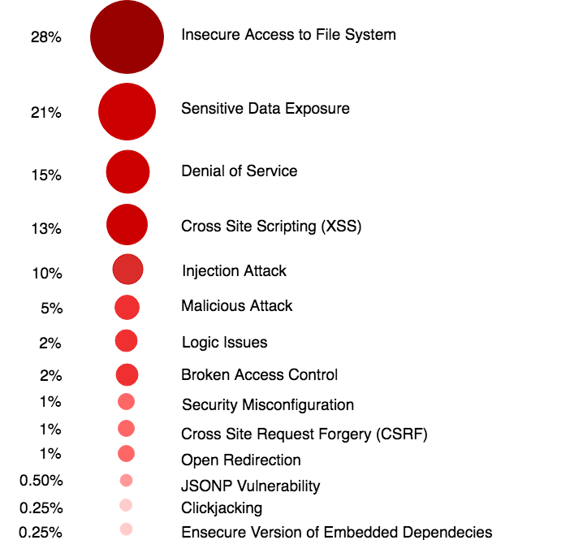
Notes:
I came up with this list of attack vectors and their frequency. This charts gives us that big picture makes it more manageable to learn from these advisories.
But it is important to clarify something.. As we saw earlier the current mass known vulnerabilities is too small. There could be security issues in Node package that are missing in this list as secruity researchers havnt dicoverd yet. Similarly, For the attack categories at bottom in this distribution list this list, are less likely to happen, Possibly security researches didn't’t focus much on them yet.
Howvever, this is a great stating point. Let review some of these attack types in more details
6:30

Slide 18
Insecure Access to File System

Slide 19
Insecure Access to File System Pattern #1 Directory Traversal
Notes:
Allows the attacker to:​
gain information about the folder structure, ​
read the contents of sensitive files on the system, ​
writing arbitrary files.

Slide 20
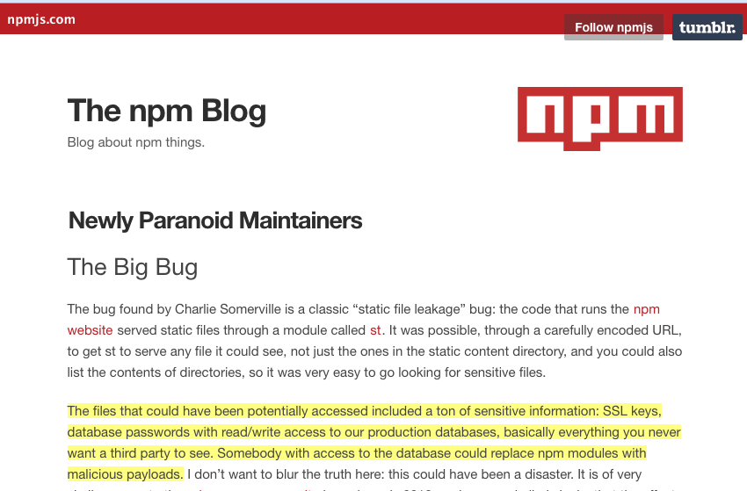
Notes:
To understand about its disastrous potential, there might not a better example than the Big Bug on npm Even though there is no evidance that it was exploited, but with it an attacker could have read any file on the npm server including Secure Sockets Layer (SSL) keys and database passwords with read/write access to the production databases,
and potentially replaced packages with malicious payloads.

Slide 21
Root Cause: An insecure dependency vulnerable to Directory Traversal
Notes:
This bug was caused by an insecure dependency vulnerable to directory traversal.

Slide 22
Root Cause behind Directory Traversal
Missing or insufficient user input validation for path traversal characters before using it in a path to serve contents on the server.

Slide 23
Root Cause for Directory Traversal
Missing or insufficient user input validation for path traversal characters before using it in a URL to serve contents on the server.
Examples:
/
../
%2f
%2e%2e/
%2e%2e%2f,
Notes:
Here are some examples including ., ../ and its encoded variations

Slide 24
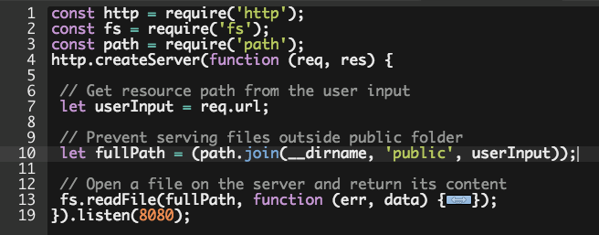
Notes:
Code like this is very common in Node packages. It shows a simple web server that serves files from a web root directory
Read comments in line 6 and 10
While constructing the fullPath to a requested resource, the code example attempts to restrict serving files beyond the web root folder.
However, it is not enough to prevent an attacker from accessing files outside of the public folder.
An attacker can manipulate the input to contain path traversal characters to navigate and access files outside of the public folder.

Slide 25
Preventing Directory Traversal
If the path needs to be supplied from the user input, sanitize the input to remove path traversal characters (./ and ../ as well as encoded variations)
Notes:
3:15

Slide 26
Insecure Access to File System Pattern #2 Symlink Attack
Notes:
Sylink attack is like Staying in a Hotel and getting a really Noisy neighbor.. That is my definition

Slide 27
Symlink Attack
Symlink attack is like staying in a hotel and getting a really noisy neighbor...

Slide 28
Symlink Attack
A malicious user sharing the host, could exploit this vulnerability to corrupt or destroy vital system or application files to which only the target application has the access.
Notes:
Here is the offical one

Slide 29
Root Cause for Symlink Attack
An application sharing the host server with other external users.
Using predictable file or folder names when writing to shared directories

Slide 30
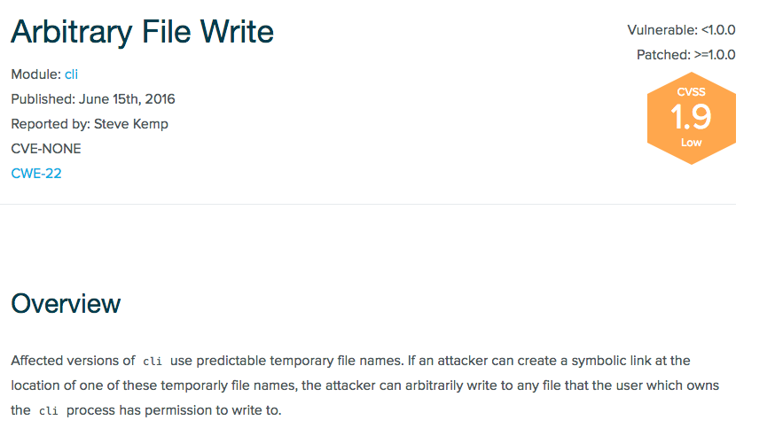
Example: The package writing logs to the shared /tmp directory with a predictable file name

Slide 31

ln –s <source file> <target file>
Notes:
To exploit this vulnerability An attacker could pre-create a symbolic link with
name of log file as a Source file
And the .bashrc file in the target user’s home directory as the target file.
As a result, When the victim application code uses the cli package and the log file /tmp/cli.app.log is generated, the .bashrc file in the application server’s home directory would be overwritten with contents of the log file.

Slide 32
Preventing Symlink Attack
Avoid using shared system folders.
Notes:
Another benefit of not writing to shared folders is that it prevents leaking file contents to other users on the host.

Slide 33
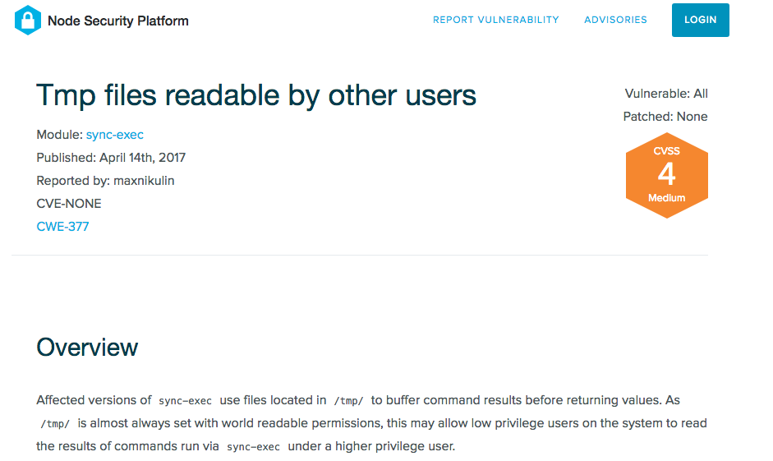
Example: The package using /tmp to buffer command results before returning values
Notes:
As /tmp/ is almost always set with world-readable permissions, this vulnerability might allow low-privilege users on the system to read the results of commands run via sync-exec under a higher-privilege user.

Slide 34
Preventing Symlink Attack
Avoid using shared system folders.
If you have to use a shared folder for writing non-sensitive data, use crypto module’s randomBytes method to generate random filenames.
Notes:
If you have to use a shared folder for writing nonsensitive data, avoid using predictable filenames.
3:54

Slide 35
Sensitive Data Exposure

Slide 36
“The more you leave out, the more you highlight what you leave in.”
- Henry Green
Notes:
it very well applies to the coding mistakes that expose sensitive information. It could give valuable clues and data to attackers.

Slide 37
Sensitive Data Exposure Pattern #1 Leaking Application Secrets

Slide 38
Root Causes for Leaking Application Secrets
Application-specific secrets appearing at insecure places such as as:
code repositories,
log files,
client-side storage,
URLs,
application global namespace
Notes:
Often unintentionally or for convenience during the development phase, application-specific secrets end up at insecure places such as:

Slide 39
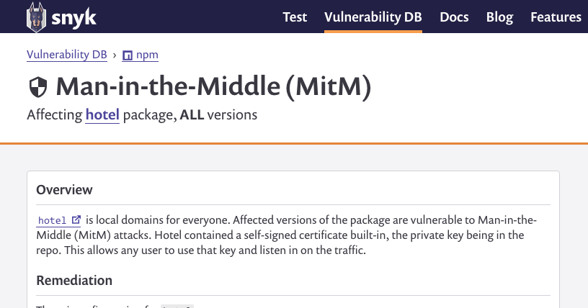
Example: Leaking the SSL private key in the code repository
Notes:
Here is vulnerability that was caused.

Slide 40
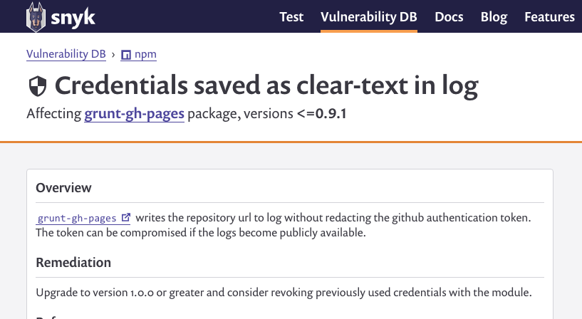
Example: URLs with authentication tokens appearing in the logs
Notes:
Here is another vulnerability that was caused by writing URLs in a log file that contained github authentication tokens

Slide 41
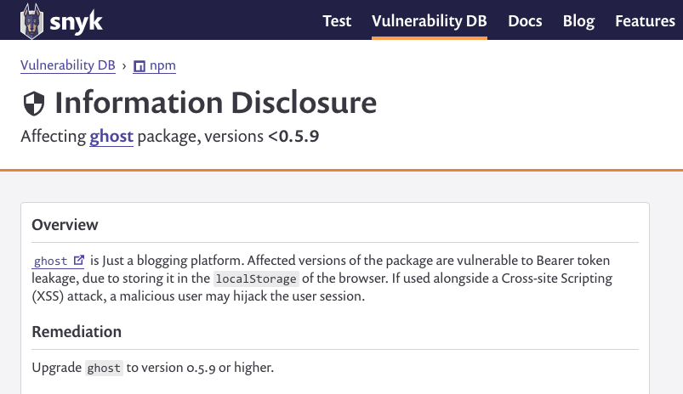
Example: OAuth Bearer Token appearing in the browser local-storage
Notes:
which can be stolen when combined with a Cross Site Scripting attack

Slide 42
Preventing Application Secrets Leakage
Securely store applications secrets in Hardware Security Module (HSM) or Key Management Services.
Notes:
Instead of storing Application secretes such as encryption keys in code repositories,
store them securely using Hardware Security Module (HSM), which is a physical device that can be plugged in to a server
Or use cloud based Key Management Services such as Vault, AWS, AZure, or Google Cloud.

Slide 43
Preventing Application Secrets Leakage
Securely store applications secrets in Hardware Security Module (HSM) or Key Management Services.
Mask any sensitive data before it appears in the log files.
Notes:
Mask any sensitive data before it appears in the log files. Mask values means partially replacing characters in the sensitive value with random characters.
There are Node packages that can help with masking.
Ensure that masking is done before a value appears in the log. This may sounds obvious, but we have recently witnessed incidents with twitter and Github, in which passwords were added to logs before they were masked.

Slide 44
Preventing Application Secrets Leakage
Securely store applications secrets in Hardware Security Module (HSM) or Key Management Services
Mask any sensitive data before it appears in the log files
To reduce impact of a leak, use short-lived tokens.
Notes:
by setting the validity time field within the protected part of the token.
3:10

Slide 45
Sensitive Data Exposure Pattern #2 Predictable Secrets (Insecure Randomness)
Notes:
Even if not exposed directly, an attacker can guess application-specific secret values if they are weak and predictable.

Slide 46
Root causes for Insecure Randomness
Using Math.random() method is to generate random values in security-sensitive context (random tokens, resource IDs, or UUIDs).
Math.random() is cryptographically insecure. It can produce predictable values.

Slide 47
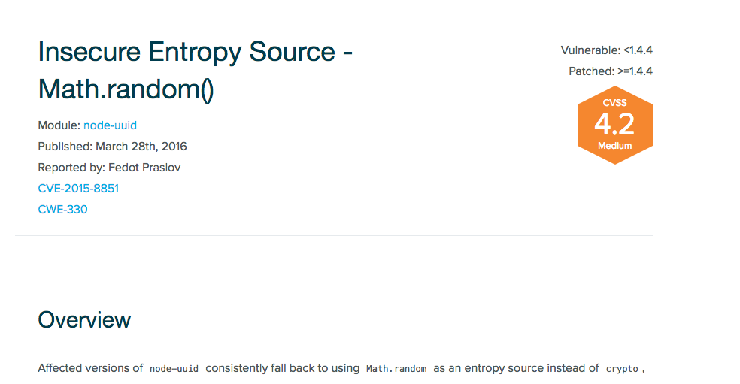
Example: Using Math.random to generate UUID

Slide 48
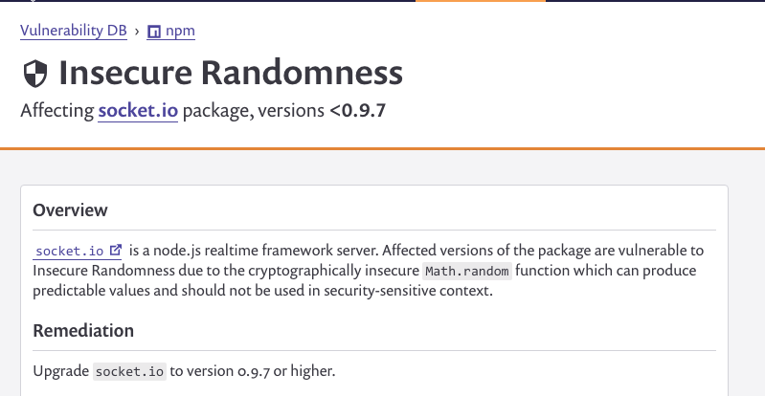
Example: Using Math.random() to generate Socket IDs

Slide 49
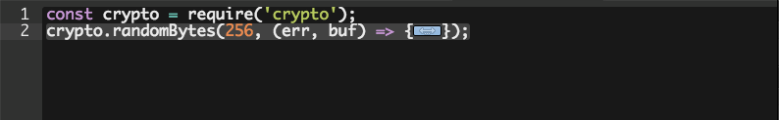
Preventing Insecure Randomness
Use crypto module to generate random numbers instead of Math.random()
Notes:
It takes two arguments: number of bytes to generate (e.g., 256) and a callback with a Buffer instance to contain the generated bytes

Slide 50
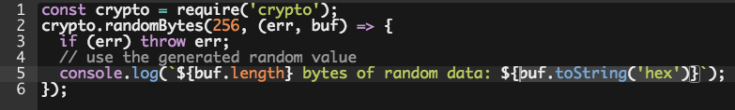
Preventing Insecure Randomness
Use crypto module to generate random numbers instead of Math.random()
Notes:
And in the callback you can use the random value in the buffer by using toString method on it

Slide 51
Sensitive Data Exposure Pattern #3 Predictable Secrets (Non-constant Time Comparison)

Slide 52
Root causes for Non-constant Time Comparison
Using fail-fast comparison logic to match user inputs against sensitive values.
JavaScript native string comparison operators (=== and ==) perform the non-constant time fail-first string comparison .
Notes:
fail-first string comparison is comparing one character at a time, and stopping when a character differs.
Thus, the execution time of a comparison operation is not constant, but instead varies depending on string values.
Even though minuscule, this time difference can enable an attacker to guess the secret value being compared one character at a time.

Slide 53
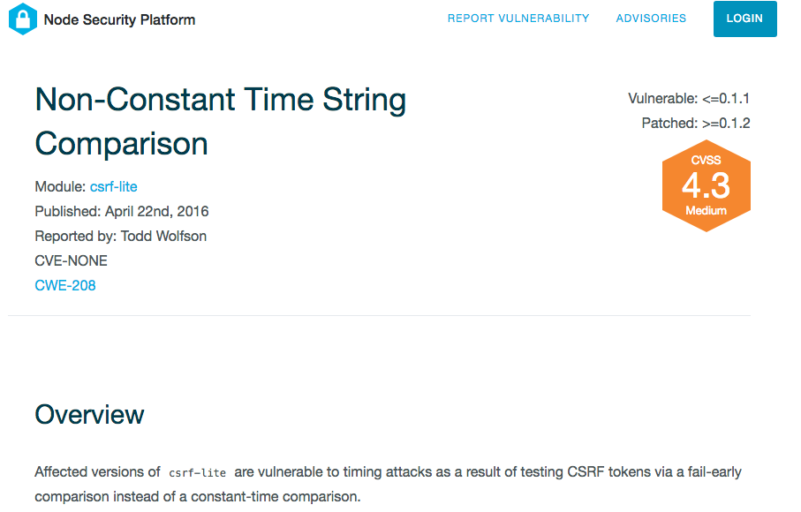
Example: Using Fail Fast operators to compare csrf tokens
Notes:
Here is a advisory cause in the csrf-lite package that used string comparison operators to validate csrf tokens

Slide 54
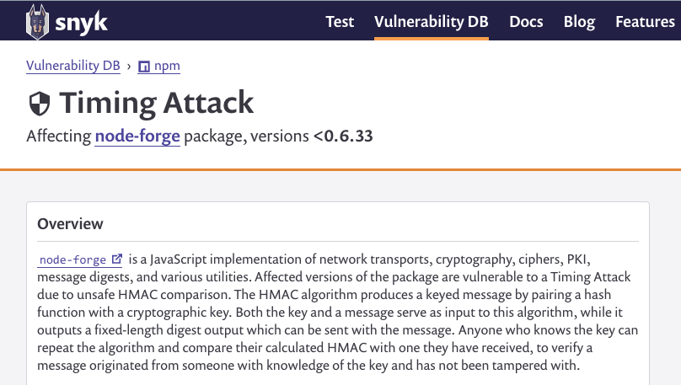
Example: Using a Fail Fast iterator to compare byte arrays
Notes:
Here is another related vulnerability that is not directly caused by using string comparison operator but had a fail-fast logic for key comparison

Slide 55
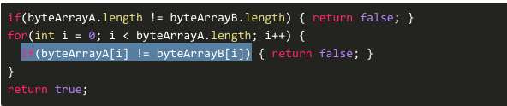
Notes:
It didn't’t use the JavaScript comparison operators but using a fast failing iterator

Slide 56
Preventing Timing Attacks
Use a constant-time comparison logic that takes the same amount of time regardless of the input values.

Slide 57
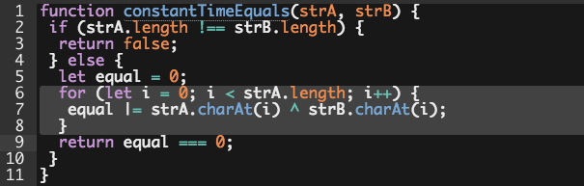
Preventing Timing Attacks
Use a constant-time comparison logic that takes the same amount of time regardless of the input values.
Notes:
As you may guess, there are node packages for this purpose.
But just for reference, here is a code example that shows a way to do a comparison of two valid string inputs by looping through it and applying an XOR operator
It then checks whether the final result is zero.
4:00

Slide 58
Sensitive Data Exposure Pattern #4 Remote Memory Exposure
Notes:
Another way by which sensitive data gets exposed is by Remote Memory Exposure. This vulnerability is very commonplace in Node packages using Buffer class

Slide 59
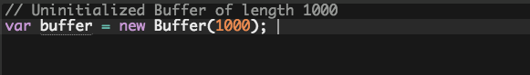
Root Cause for Remote Memory Exposure
Prior to Node.js 8, the Buffer constructor that takes a number as an argument, generates a Buffer instance with uninitialized underlying memory.

Slide 60
Root Cause for Remote Memory Exposure
Prior to Node.js 8, the Buffer constructor that takes a number as an argument, generates a Buffer instance with uninitialized underlying memory.
The contents of a newly created Buffer remain unknown and might contain sensitive data.
Notes:
This default behavior caused widespread vulnerabilities in Node packages, Here are some examples:

Slide 61
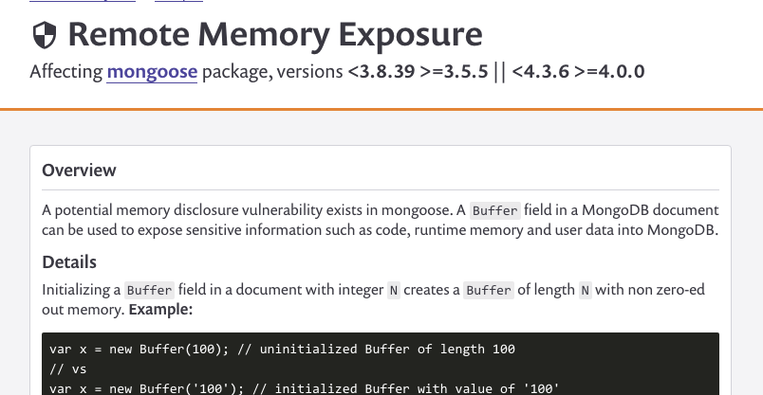
Examples of Uninitialized Memory Exposure
Example: Using unsafe Buffer constructor

Slide 62
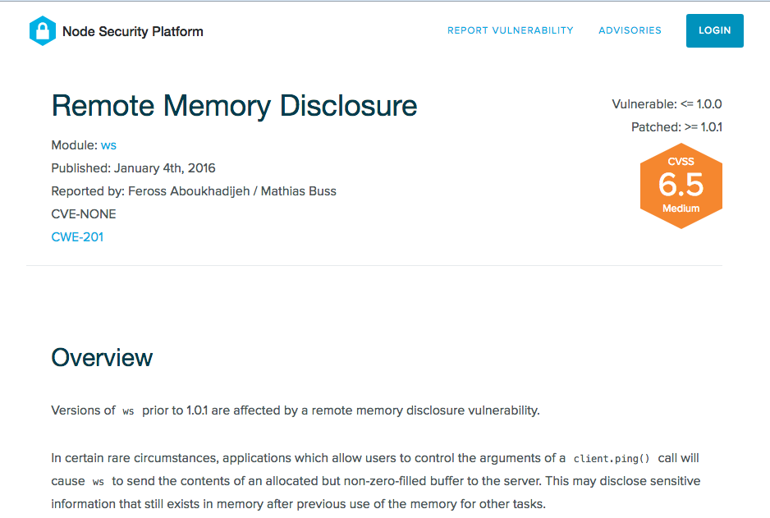
Example: Using unsafe Buffer constructor

Slide 63
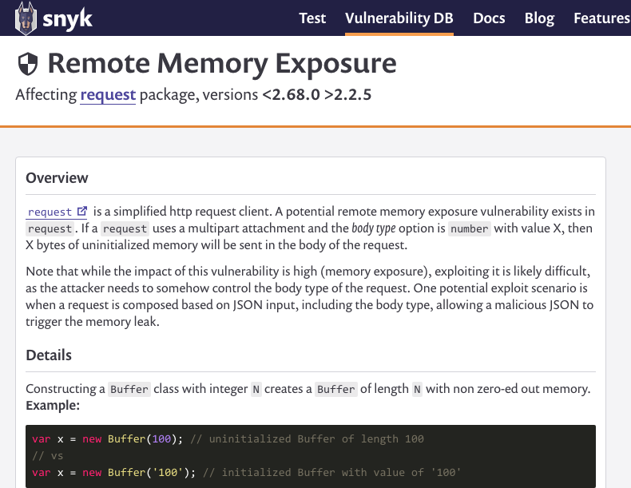
Example: Using unsafe Buffer constructor

Slide 64
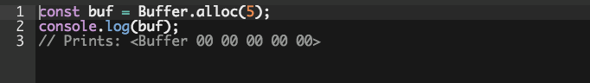
Preventing Remote Memory Exposure
Use a safe method Buffer.alloc(size) to create a buffer that is initialized with zeroes:
Notes:
In Node 8 and above the Buffer constructor that takes number as argument is fixed, it returns a buffer instance filled with zeros, but it is deprecated.

Slide 65
Sensitive Data Exposure Pattern #5 Insecure Network Usage
Notes:
This is a very wide spread vulnerability and often found in the Node packages that download native binaries written in C/C++ to perform resource-intensive operations.

Slide 66
Root Cause for Insecure Network Usage
Using insecure HTTP protocol to download resources as part of install scripts or at runtime.

Slide 67
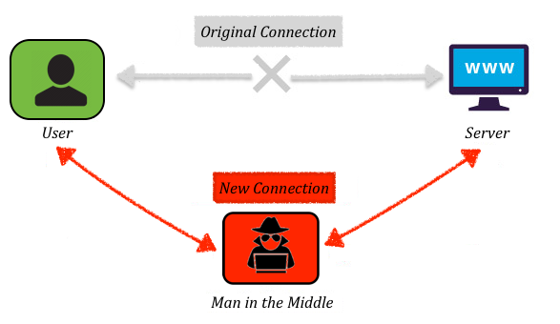
Root Cause for Insecure Network Usage
Using insecure HTTP protocol to download resources as part of install scripts or at runtime.
Notes:
An attacker can exploit an insecure connection by secretly intercepting and altering the communication, which is also known as the MitM Attack.
The attacker can swap out the requested binary with a malicious version while the binary files are being downloaded over HTTP.
The attacker-controlled binary can then facilitate Remote Code Execution on the victim’s machine.

Slide 68
Preventing Insecure Network Usage
Download resources over secure HTTPS connection.
Provide an option for users to download dependencies in advance and specify the location path.
Notes:
as part of an environment variable or a .npmrc configuration parameter.

Slide 69
Denial of Service
Notes:
Denial-of-Service (DoS) attacks are the most disastrous. When successful, an attacker can prevent all legitimate users from accessing the service.
We can find three patterns by which DoS vulnerabilities are manifested in Node packages.

Slide 70
Denial of Service Pattern #1 Exhausting System Resources

Slide 71
Root Cause behind DoS by Exhausting System Resources
Allocating unrestricted amount of system resources based on the size of a user input.
Notes:
The first mechanism is by exhausting system resources such as CPU, memory, disk space by sending large payloads
Lets see some examples

Slide 72
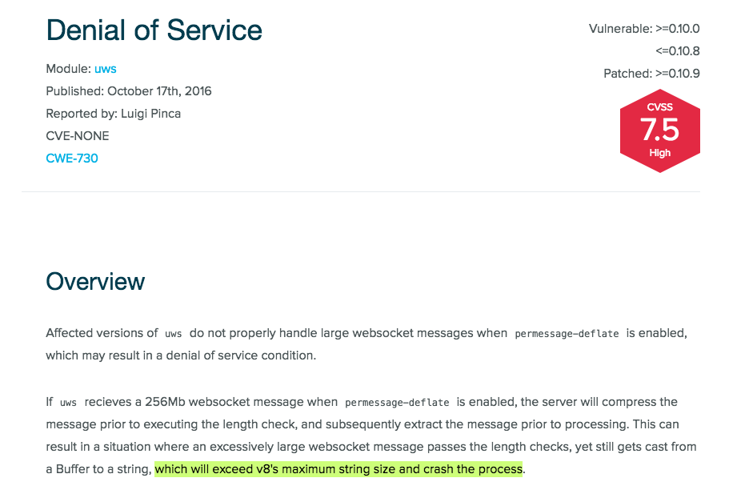
Example: Exceeding V8’s maximum string size limit

Slide 73
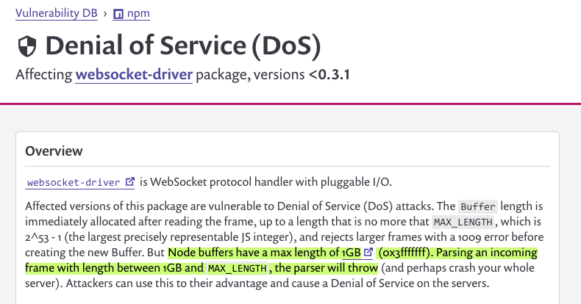
Example: Exceeding V8’s maximum buffer size limit
Notes:
Here is an example of DoS advisory that was caused

Slide 74
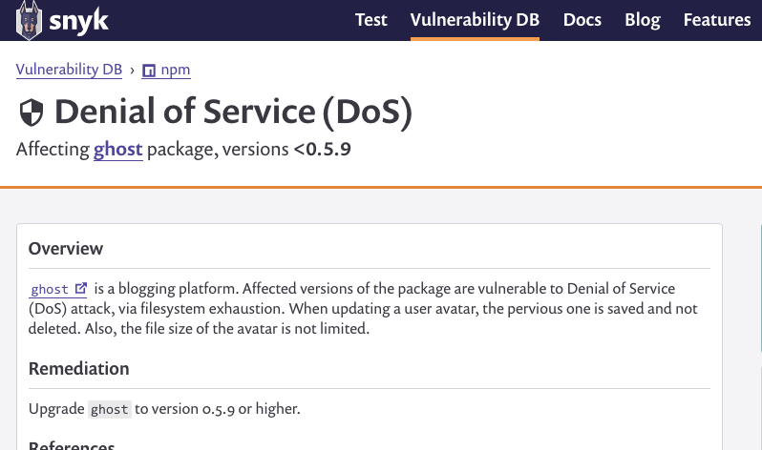
Example: Unrestricted file uploads exhausting file-system space

Slide 75
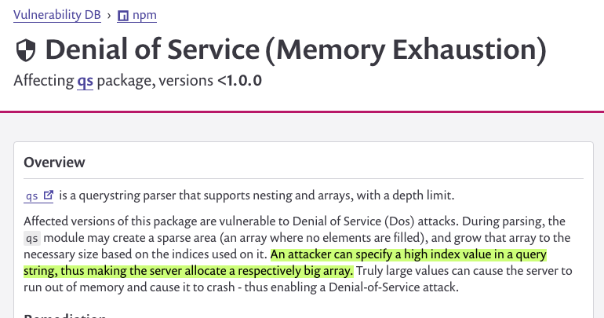
Example: Instantiating large number of Objects based on a user input (very large array index: foo[0][1000000000]=bar)
Notes:
If as an input, if an attacker specifies a very high index value in query string, it attempts to creates an array of that size of runs out of memory

Slide 76
Preventing DoS by Exhausting System Resources
Validate size of a user input before processing it

Slide 77
Denial of Service Pattern #2: Keeping Event Loop Busy
Notes:
This pattern is opposite of earlier one. Instead of sending large payloads an attacker can exploit it by sending a small but specially crafted input targeting the event loop

Slide 78
Node is fast when the work associated with each client at any given time is "small".
- Node.js Docs
Notes:
Article – don’t block the event loop

Slide 79
Examples of DoS By Keeping Event Loop Busy
Running an execution loop whose iterations depend on the length of a user input.

Slide 80
Examples of DoS By Keeping Event Loop Busy
Running an execution loop whose iterations depend on the length of a user input.
Using unsafe Regular Expressions

Slide 81
Regular Expression Denial of Service (ReDoS)
By default, regular expressions get executed in the main event loop thread
Evil regex can take exponential execution time when applied to certain non-matching inputs.

Slide 82
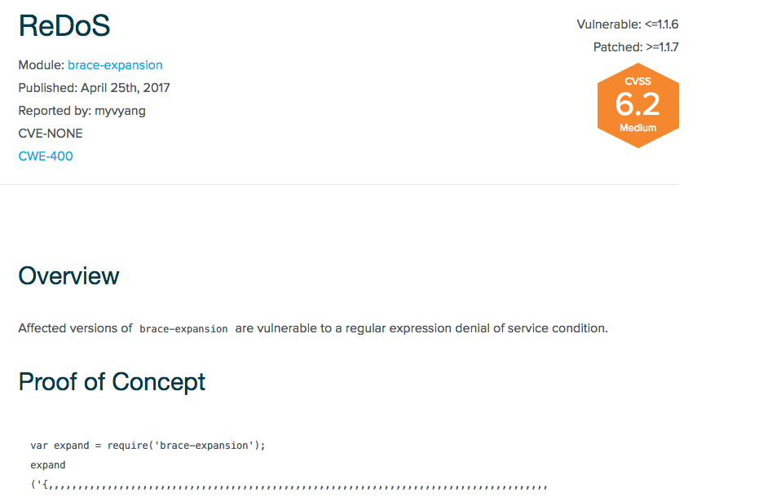

Slide 83
^(.*,)+(.+)?$/

Slide 84
Input format: ,,,,,,,,,,,,,,,,,,,,,,,,,,,,,,,\n
Input Length | Execution Time
25 | 2 sec
26 | 4 sec
27 | 9 sec
28 | 15 sec
30 | 1 minute
35 | 34 minutes
Notes:
With every additional comma in a user input.
How powerful attack vector this is for an attacker.. No need to constrcut and upload huge payloads

Slide 85
Denial of Service Pattern #3 Crashing Event Loop By Unhandled Exceptions
Notes:
The another commonly found reason for Denial of Service Attack is unhandled exceptions

Slide 86
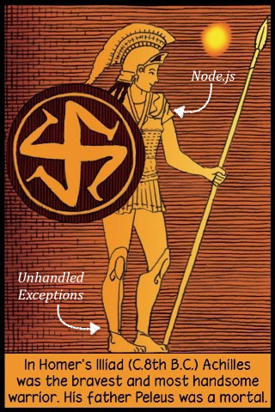
Notes:
Unhandled exceptions are akilis heel for Node.js applications, as it crash the event loop
Next, lets see common sources and coding mistakes that can cause unhandled exceptions in Node packages

Slide 87
Common Causes of Unhandled Exceptions
#1 Failing to Handle Invalid User Inputs

Slide 88
Caused by failing to validate user inputs for unexpected value, type, or shape before processing them
Notes:
Invalid values: negative values, unexpected characters, out of range values, unicode characters, etc
Or unexpected type, or shape

Slide 89
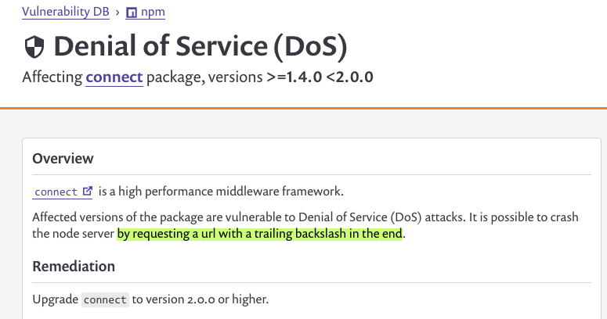
Unexpected Character
Example: Trailing \ in URL localhost:3000/index.html\
Notes:
Other examples can include unicode characters, out of range values, etc

Slide 90
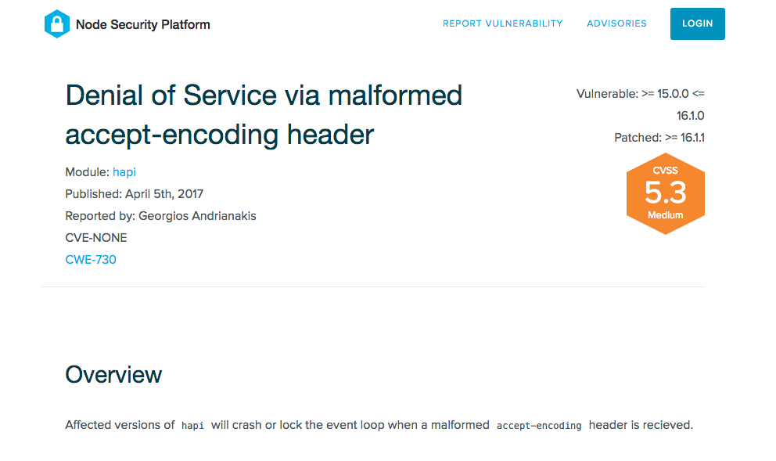
Unexpected Object Value
Example: Unexpected HTTP Header Value { 'accept-encoding': 'a;b' }
Notes:
Accept encoding header

Slide 91
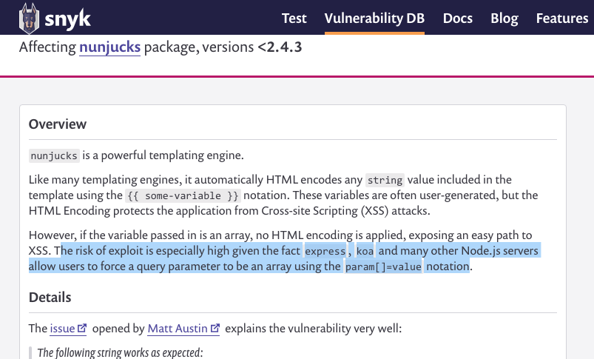
Unexpected Object Shape
Example: Type coercion via HTTP Request Parameters
Notes:
Accept encoding header

Slide 92
User input coercion via HTTP Request Parameters in qs, Express, Koa
// GET /search?conference=fluent
request.query.conference
//=> "fluent”
Notes:
It is important to know about query parameter coercing mechanisms in Express, Koa or any framework that uses qs, body-parser, packages
Using this an attacker can change type of the HTTP Request parameter object on the server

Slide 93
User input coercion via HTTP Request Parameters in qs, Express, Koa
// GET /search?conference=fluent&conference=velocity
request.query.conference
//=> ["fluent”, “velocity”]

Slide 94
User input coercion via HTTP Request Parameters in qs, Express, Koa
// GET /search?conference[]=fluent
request.query.conference
//=> ["fluent”]

Slide 95
User input coercion via HTTP Request Parameters in qs, Express, Koa
// GET /search?conference[fluent][year]=2018
request.query.conference
//=>

Slide 96
User input coercion via HTTP Request Parameters in qs, Express, Koa
// GET /search?conference[fluent][year]=2018
request.query.conference
//=> {fluent: { year: '2018' }}
Notes:
If you have written logic on server assuming that query paramerters are always string, you might get a TypeError, and it would the crash the server

Slide 97
Preventing Unhanded Exception Caused by Invalid User Input
Validate user inputs for expected values, type or shape before processing it. (using joi package, for example)
Notes:
V

Slide 98
Common Causes of Unhandled Exceptions
#2 Missing or Incorrect Operational Error Handling

Slide 99
Four mechanisms to communicate operational errors in Node.js:
throw new Error('something bad happened!');
Notes:
To process the error correctly, we need to be aware of the error delivery mechanism used by the invoked function and handle it accordingly.
throw clause to delivers an error synchronously — used with try/catch

Slide 100
Four mechanisms to communicate operational errors in Node.js:
throw new Error('something bad happened!');
callback(new Error('something bad happened!'));
Notes:
2nd way is by Invoking a callback function, which takes error as a first argument

Slide 101
Four mechanisms to communicate operational errors in Node.js:
throw new Error('something bad happened!');
callback(new Error('something bad happened!'));
return Promise.reject(new Error('something bad happened!'));
Notes:
We can also Returns a Promise object that is rejected with the given reason.

Slide 102
Four mechanisms to communicate operational errors in Node.js:
throw new Error('something bad happened!');
callback(new Error('something bad happened!'));
return Promise.reject(new Error('something bad happened!'));
myEmitter.emit('error', new Error(something bad happened!'));
Notes:
For more complicated cases, instead of using a callback, the function itself can return an EventEmitter object, and the caller would be expected to listen for error events on the emitter.

Slide 103
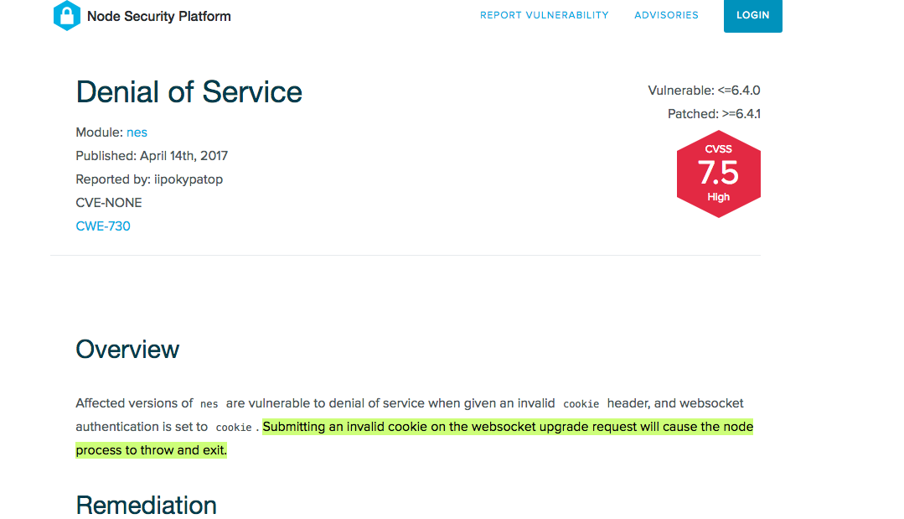
Example: Failure to handle error object passed in the callback

Slide 104
Preventing Unhanded Exception due to Operational Errors
Be aware of the error delivery mechanism used by the invoked function and handle errors accordingly.
Notes:
To process the error correctly, we need to be aware of the error delivery mechanism used by the invoked function and handle it accordingly.

Slide 105
Recap
Insecure Access to File System
Pattern #1 Directory Traversal
Pattern #2 Symlink Attack

Slide 106
Recap
Sensitive Data Exposure
Pattern #1 Leaking Application Secrets
Pattern #2 Predictable Secrets (Insecure Randomness)
Pattern #3 Predictable Secrets (Non-constant Time Comparison)
Pattern #4 Remote Memory Exposure
Pattern #5 Insecure Network Usage

Slide 107
Recap
Denial of Service
Pattern #1 Exhausting System Resources
Pattern #2 Keeping Event Loop Busy
Pattern #3 Crashing Event Loop By Unhandled Exceptions

Slide 108
Learning Resources

Slide 109
Learning Resources

Slide 110
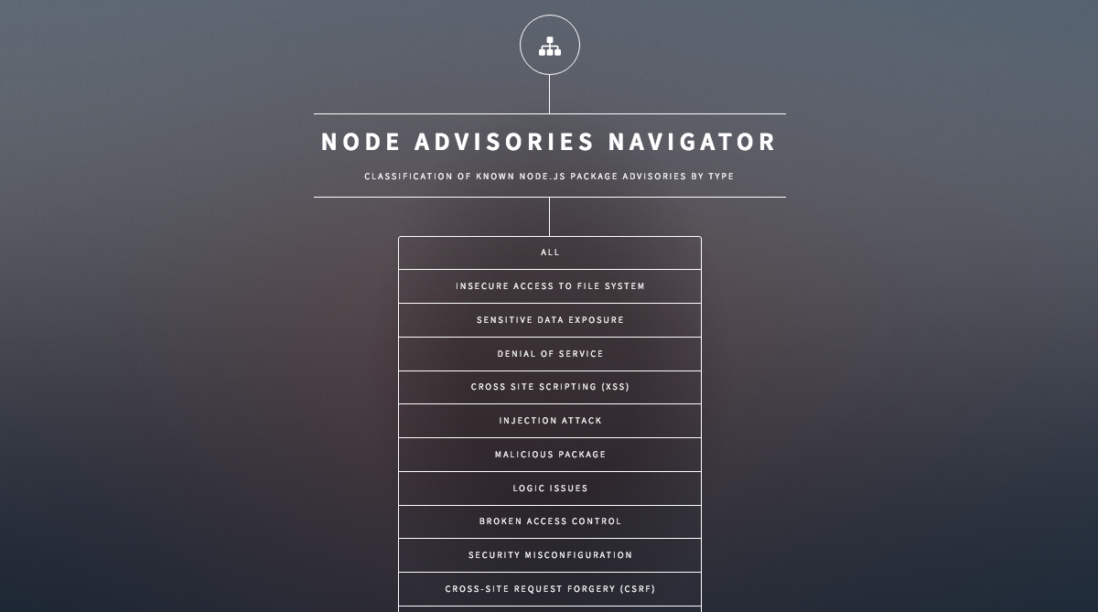
node.advisories.io

Slide 111
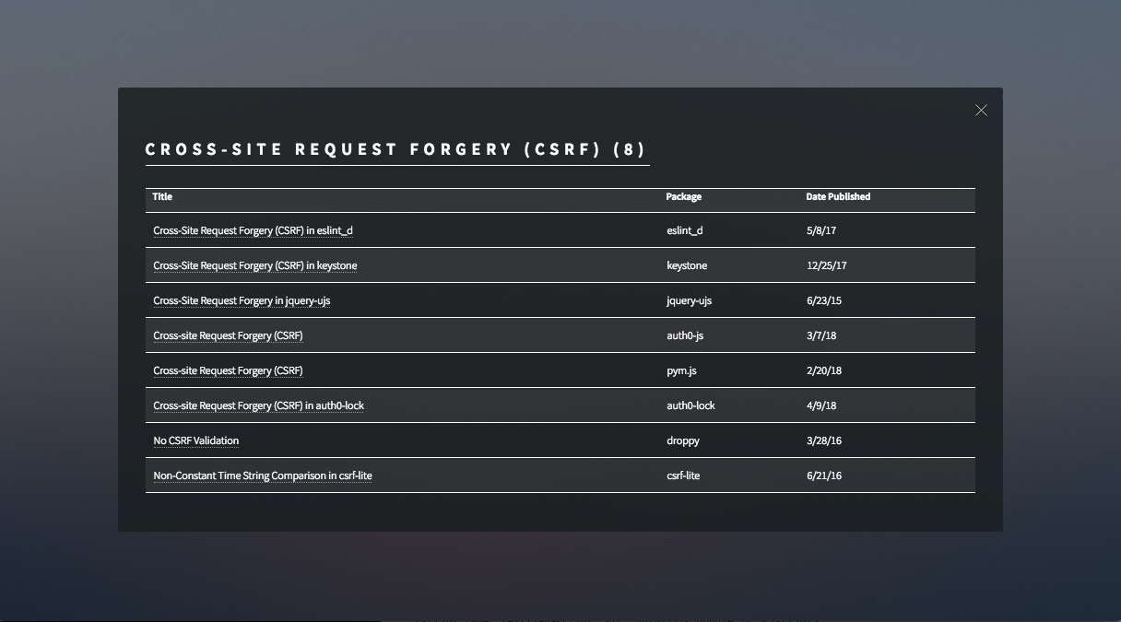
node.advisories.io

Slide 112
@karande_c

